Slide 1
IMDB Entertainment Ratings Project
I 320D Data Engineering
Tanya Arya,
Claire Chun,
Wai Kei Rachel Foong,
Serena Manwani

Slide 2
Table of Contents
01
INTRODUCTION
04
DATA PRODUCTS
02
REQUIREMENTS
05
DEMO
03
ER Diagram

Slide 3
Goals
Design and implement a data pipeline
Internet Movie DataBase (IMDB) dataset
Transform raw data into an organized Star Schema
Meaningful insights through visualization
Decision Making, identify trends and measure performance
Data Modeling
Staging Tables
Data Transformation
Data Products
Data Visualization
Steps
Animation
Comedy
Family
Musical
Romance
Genres
Data
CSV files contain directors, actresses, actors
INTRODUCTION

Slide 4
REQUIREMENTS
What are the top 10 highest rated movies for the last 5 years?
What directors (with at least 3 movies) have the highest average rating?
What actresses (with at least 3 movies) have the highest average rating?
What actors (with at least 3 movies) have the highest average rating?
What are the 3 highest rated movies in each genre?

Slide 5
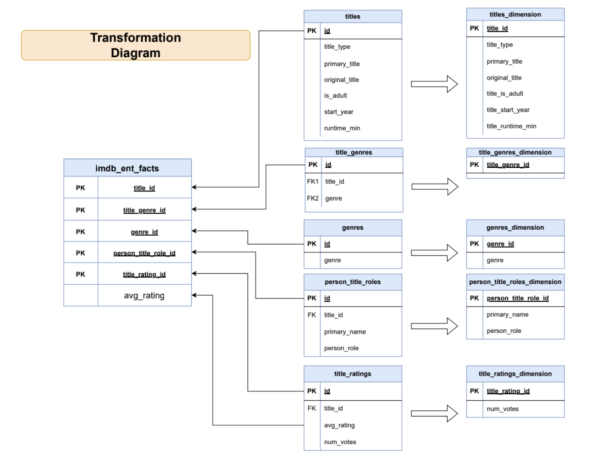
Cleaned and transformed the raw IMDB dataset
Dropped specific columns, including end_year and title_id (starts with tt)
Avoided data redundancy and inconsistencies within the data
Notable discrepancy between “music” and “musical” columns, so we dropped rows with the genre being “music”

Slide 6
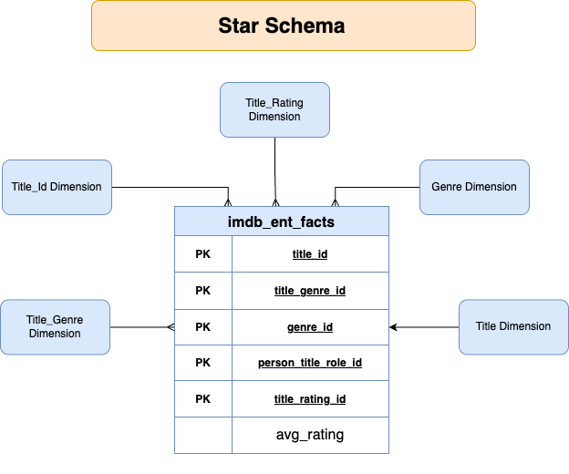

Slide 7
Data Products
01
02
Questions 1 & 5
Simplifies the process of
Ranking movies by genre
Identifying highest-rated movies by genre
Questions 2, 3, 4
Simplifies the process of
Identifying highest-rated directors, actors, and actresses
Identifying top-rated movies by ratings and number of votes

Slide 8
Dashboard

Slide 9
THANK YOU!

